Slide 1
AI in Everyday Life: Enhancing Efficiency and Addressing Challenges
Team 6
Konstantinos Raptis, Satchel Benn, Casey Green, Alex Washington

Slide 2
Introduction
Agenda Overview
Problem Statement
Discussion of Relevant Research
Technical Coding Demo
Ethical Concerns
Future Developments

Slide 3
Problem Statement
Problem: AI assistants can help those with limited accessibility and efficiency in personal scheduling. Provides management for individuals with high-demand lifestyles. AI addresses the personalization of customer experiences in various sectors, which involves leveraging AI technologies to analyze vast amounts of data for more accurate predictions and personalized recommendations, which significantly improves user interaction and satisfaction
Relevance: This issue is particularly relevant in today's discussions on AI, as it reflects ongoing advances in AI technologies and their integration into everyday business practices, emphasizing the transformational impact AI has on daily operations and consumer interactions.

Slide 4
Relevant Research
For our project on AI in everyday life, focusing on the advanced algorithms in AI-driven personal assistants, we can examine the research outlined in the paper titled "AI-Driven Anonymization(Data Masking): Protecting Personal Data Privacy" by L. Yang (2024). This paper is particularly relevant to the efficiency of AI and its data privacy concerns, an increasingly critical area in the use of personal assistants.
Methodology
Yang’s study employs a combination of machine learning techniques to enhance data anonymization processes. By integrating these advanced algorithms, the paper evaluates the effectiveness of AI-driven models in efficiency of daily task and protecting personal information against various types of data breaches and unauthorized access.
Findings
The paper reports that AI-driven anonymization significantly enhances the security of personal data while maintaining the utility of the data for analysis and personalization services. It establishes benchmarks showing improvements over traditional data anonymization techniques, which often compromise data usefulness.
Relevance
This research is crucial for our problem statement as it addresses a significant concern with AI-driven personal assistants—ensuring user privacy while providing an efficient personalized experience. As personal assistants become more involved in our daily lives, ensuring the privacy and security of the data they process is paramount. This paper's findings contribute to developing more secure AI systems that can still deliver highly personalized user interactions, aligning with the goal of our project to explore efficient and safe uses of AI in daily life.

Slide 5
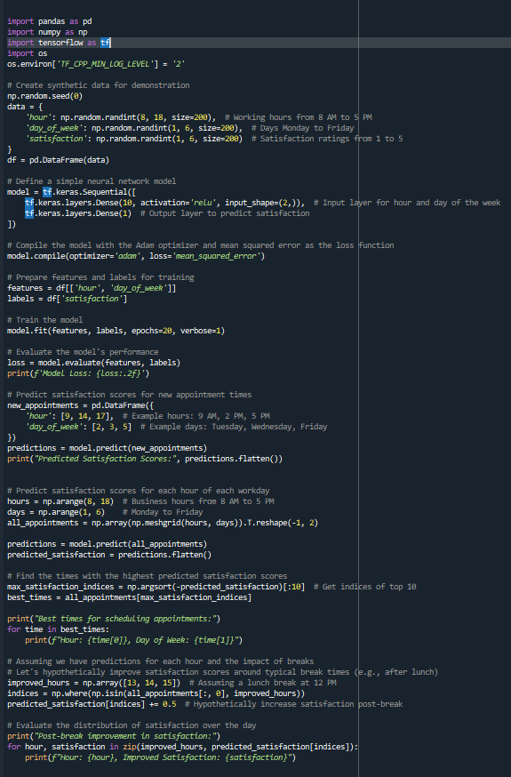
Technical Coding Demo
Develop a model that predicts optimal meeting times to enhance scheduling efficiency.
Notes:
We've constructed a neural network model . Our goal is simple: optimize meeting times to boost employee satisfaction."
Now, to ensure our model learns effectively, we utilize what’s known as the Adam optimizer.the lowest error possible. For our model, that error is measured by the mean squared error, which tells us how close our AI's predictions are to the actual satisfaction scores."
As we train our model over 20 rounds, which we call epochs, it’s learning from our synthetic data — composed of hours and days when meetings occur and the corresponding satisfaction ratings. With each epoch, it's as if our model is practicing and getting better, adjusting its internal parameters to predict satisfaction more accurately."

Slide 6
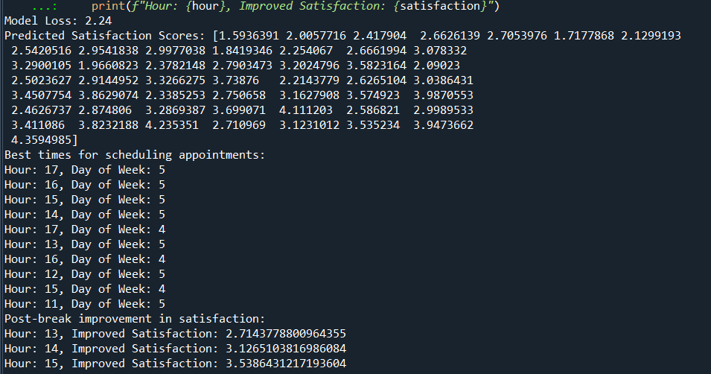
Model Insights and Business Applications
Model Training Results:
Successfully trained over 20 epochs, showing convergence with a final model loss of 2.24, indicating a moderate level of prediction error.
Optimal Scheduling Windows Identified:
Top times for appointments were consistently in the later hours of the workday, suggesting a preference for meetings towards the end of the typical 9-to-5 schedule.
Post-Break Satisfaction Increase:
Noticeable improvements in predicted satisfaction scores post-lunch hours, hinting at better meeting receptiveness after breaks.
Business Application:
The model can be integrated into scheduling systems to suggest times that may lead to higher employee satisfaction and efficiency.
Conclusion:
AI models can provide valuable insights for workplace schedule optimization, potentially enhancing employee contentment and productivity.

Slide 7
Ethical Concerns
When discussing the ethical concerns associated with AI applications, particularly in AI-driven personal assistants, several critical issues emerge:
Privacy: When using real data, especially involving employee activities and preferences, it's important to handle such data with care to respect privacy rights. Predictive models that use personal data might risk exposing individual preferences or behaviors. Implement robust data protection measures, anonymize data where possible, and ensure compliance with privacy laws such as GDPR in Europe or CCPA in California.
Bias in AI: If the synthetic data used to train the model does not accurately represent the diverse real-world scenarios, including all groups of employees, the model may inherit these biases. This could result in recommendations that favor certain groups over others based on time preferences or availability. It’s crucial to ensure the training data encompasses a wide range of employee profiles and preferences to prevent any group from being systematically disadvantaged by the scheduling model.
Impact on Employment: If the model consistently schedules meetings at times calculated to be the most efficient, it could inadvertently increase stress or work pressure by optimizing for productivity at the expense of employee well-being. The model should consider not just the isolated metric of satisfaction or efficiency but also broader impacts on employee health and corporate culture.
Addressing these ethical concerns requires a comprehensive approach, including the development of more transparent AI systems, strong measures to reduce bias in AI, and policies that protect privacy and manage the economic impact of automation.

Slide 8
The Future
As AI technology continues to advance, its impact on everyday life is expected to grow significantly across various sectors. Here are some key developments anticipated in the near future:
Increased Efficiency and Personalization: AI is set to enhance the efficiency and personalization of daily activities, from how we manage our homes with smart devices to how we shop online. AI-powered systems will learn from individual behaviors to tailor experiences, making them more user-friendly and efficient.
Transportation and Mobility: AI will further revolutionize transportation through autonomous vehicles and smarter traffic management systems, reducing accidents, optimizing traffic flow, and improving overall transportation safety and efficiency.
Enhanced Home and Work Environments: In both the home and workplace, AI is expected to automate routine tasks, freeing up individuals for creative and strategic activities. This could lead to a better balance between work and life and enhance productivity and job satisfaction.
As these technologies evolve, ethical and regulatory challenges will need to be addressed, particularly concerning privacy, bias, and impact on employment, ensuring that AI's benefits are distributed equitably across society.

Slide 9
Sources
"AI-Driven Anonymization: Protecting Personal Data Privacy While Leveraging Machine Learning." arXiv.org, arXiv, 24 Feb. 2022, arxiv.org/abs/2402.17191.
Mennella, Ciro, et al. "Ethical and Regulatory Challenges of AI Technologies in Healthcare: A Narrative Review." Author Information Article Notes Copyright and License Information PMC Disclaimer, PubMed Central, https://www.ncbi.nlm.nih.gov/pmc/articles/PMC10879008/.
"Ethical Considerations of Artificial Intelligence." CapTech University Blog, CapTech University, n.d., https://www.captechu.edu/blog/ethical-considerations-of-artificial-intelligence.
Yelne, Seema, et al. "Harnessing the Power of AI: A Comprehensive Review of Its Impact and Challenges in Nursing Science and Healthcare." Journal of Nursing Science, vol. 35, no. 1, 2022, PubMed Central, https://www.ncbi.nlm.nih.gov/pmc/articles/PMC10744168/.
Nguyen, Chi. "AI-Powered Virtual Assistants Enhancing Efficiency in the Workplace." SmartDev, 25 Mar. 2024, www.smartdev.com/ai-powered-virtual-assistants-enhancing-efficiency-in-the-workplace/.

